Slide 1
AQA
A Level
Computer Science
Paper 1
Limits of computation
Unit 8
Algorithms

Slide 2
Objectives
Be aware that algorithmic complexity and hardware impose limits on what can be computed
Know that algorithms may be classified as being either tractable or intractable
Be aware that some problems cannot be solved algorithmically
Describe the Halting problem, and understand its significance for computation

Slide 3

Computable problems
A problem is defined as being computable if there is an algorithm that can solve every instance of it in a finite number of steps
Are all computational problems computable?
What exactly is a computational problem?

Slide 4

An incomputable problem

Slide 5
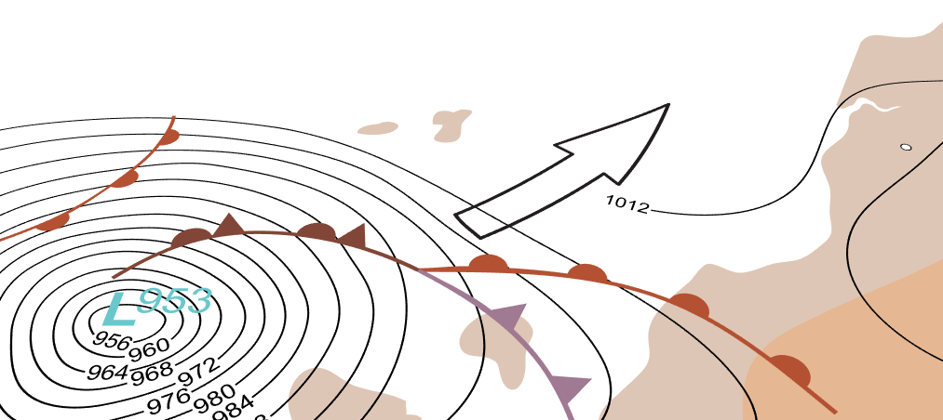
A computational problem
Some problems may be theoretically soluble by computer but if they take millions of years to solve, they are, in a practical sense, insoluble
Some problems, like weather forecasting, have to be computed within a few hours for the forecast to be useful

Slide 6
Limits of computation
Limits are imposed by
Algorithmic complexity
Hardware
Problems that were insoluble 50 years ago have now become computable
In 1916, it took the mathematician Lewis Richardson several weeks to produce a 6-hour weather forecast
It turned out to be highly inaccurate…

Slide 7

The travelling salesman problem (TSP)
“Given a list of towns and the distances between each pair of towns, what is the shortest possible route that the salesman can use to visit each town exactly once and return to the starting point?”

Slide 8
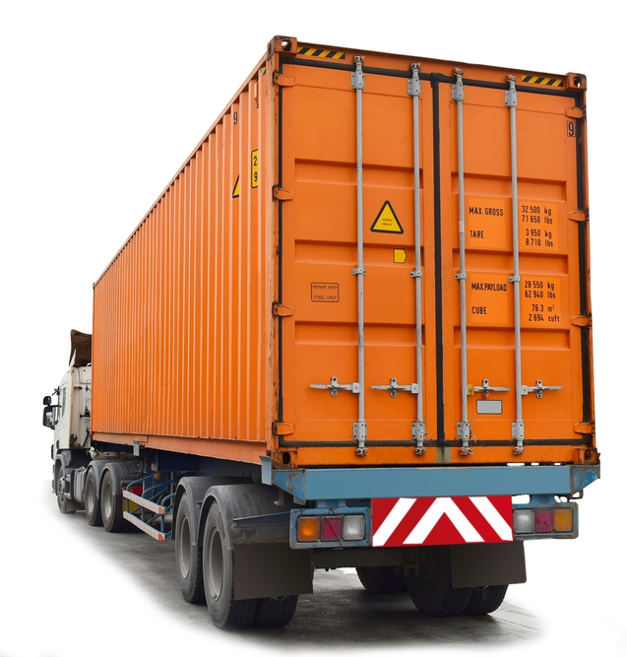
An optimisation problem
The TSP is a very well known optimisation problem
It has applications in planning, logistics, transportation, manufacture of circuit boards and many other fields

Slide 9
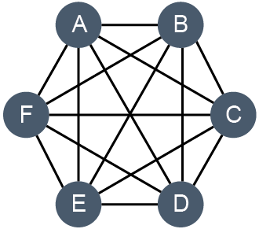
Brute force method
One way of attempting to solve the problem is the brute force method
Using this method, all possible routes are tested
With five cities, there are 4 x 3 x 2 x 1 = 24 possible routes – that’s 4! (4 factorial)
How many possible routes are there with
6 cities?
10 cities?
20 cities?

Slide 10
Solving the TSP
The problem quickly becomes impossible to solve within a reasonable time
Even with only 10 cities, there are more than three million possible routes
With 50 cities, the number of possible routes is a 65-digit number!
This is an example of an intractable problem
It has time complexity O(n!)

Slide 11
Tractable problems
A problem that has a polynomial-time solution or better is called a tractable problem
Algorithms with time complexities O(n), O(n²), O(n^{k}) are all ‘efficient’ algorithms for solving problems
What about an algorithm with time complexity O(n log n)?
An example of a tractable problem is “Sort n numbers into ascending numerical sequence”
What is another example of a tractable problem?

Slide 12
Intractable problems
An intractable problem is one that does not have a polynomial time solution
Algorithms of time complexity O(2^{n}) and O(n!) are examples of inefficient algorithms
Although the problem may have a theoretical solution, it is impossible to solve it within a reasonable time for values of n greater than something very small
Is intractable the same as insoluble?

Slide 13
Worksheet 6
Complete Task 1 on the worksheet
Password: h&r+BQ.f

Slide 14
Heuristic methods
Not all intractable problems are equally hard
Not all instances of an intractable problem are equally hard
It may be relatively easy to get an approximate answer that is good enough
A heuristic approach is one which tries to find a solution which may not be perfect but which is adequate for its purpose

Slide 15
Heuristic solutions
A large number of heuristic solutions have been developed for the Travelling Salesman Problem (TSP)
These can find a solution within 2 - 3% of an optimal solution for up to 85,000 ‘cities’ or nodes
Virus scanners often use heuristic rules

Slide 16
Do you use heuristic methods?
A heuristic approach is often used in decision-making
Using a ‘rule of thumb’
Making an ‘educated guess’
Using common sense
Researchers have found that ignoring some of the relevant information can lead to better decisions

Slide 17
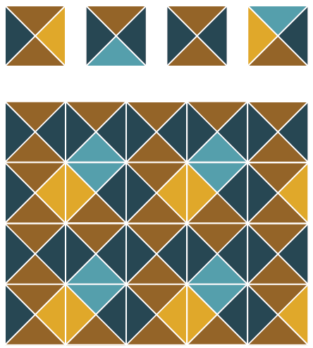
Computable and non-computable problems
Some problems cannot be solved algorithmically
The ‘four tile problem’ is an example of a non-computable problem
Look it up at www.cs4fn.org

Slide 18
Non-computable problems
Problems such as face-recognition or flying an airliner across the Atlantic with no human intervention may once have seemed non-computable, but are now routine
However, Alan Turing proved in 1936 that some problems are non-computable
Computer Science is sometimes defined as “the study of problems that are and are not computable”

Slide 19
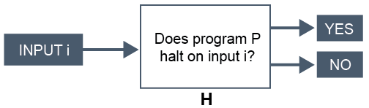
The Halting problem
This is the problem of determining for a given input, whether a program will finish running or continue for ever
It can be represented graphically:

Slide 20
The Halting problem
Alan Turing proved in 1936 that a machine H to solve the Halting problem for all possible programs and their inputs, cannot exist
It is not possible to devise a program H which can show that, given any program and its inputs, it will halt or continue for ever
It is, however, often possible to show that given a specific algorithm, it will halt for any input

Slide 21
The significance of the Halting problem
What the Halting problem shows is that there are some problems that cannot be solved by computer

Slide 22
Worksheet 6
Complete the questions in Task 2 of the worksheet

Slide 23
Plenary
Some problems are non-computable
Not every computational problem has a solution
A tractable problem has a polynomial-time solution or better
The Travelling Salesman problem is a classic example of an intractable problem
The Halting problem shows that there are some problems that cannot be solved by computer

